Slide 1

Structures and Pointers
Joffy's Insights

Slide 2

Joffy's Insights

Slide 3
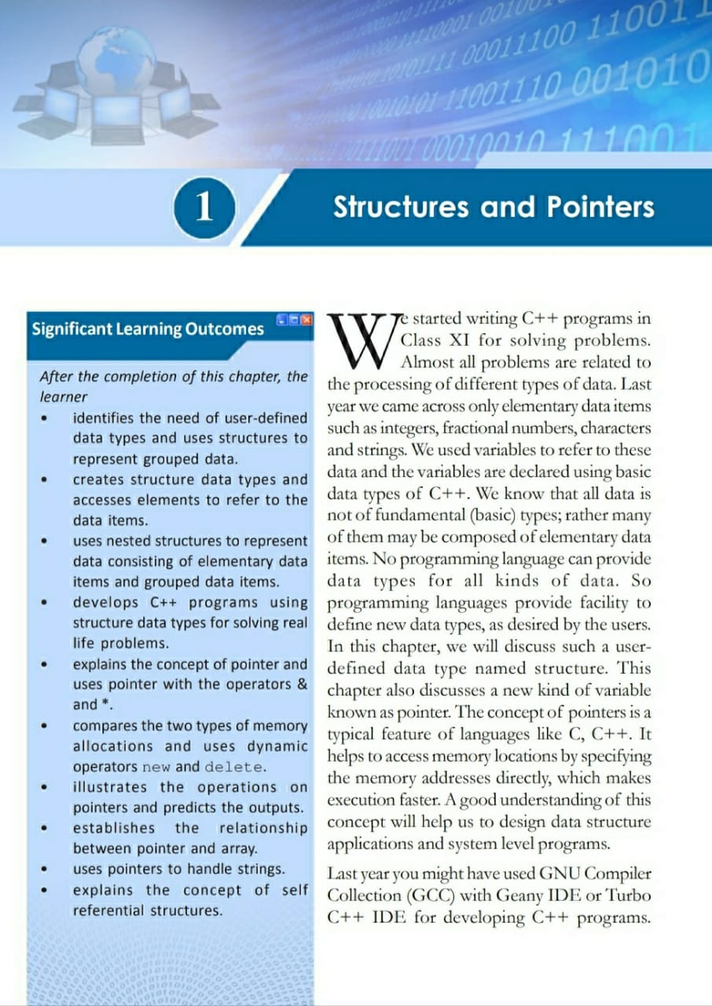
Joffy's Insights

Slide 4

Geany IDE
Joffy's Insights

Slide 5

GNU Compiler Collection(GCC)
Joffy's Insights

Slide 6
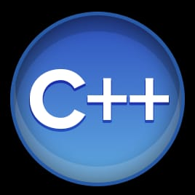
Joffy's Insights

Slide 7
Structures
Joffy's Insights

Slide 8
Structure
Structure is a user defined data type
to represent logically related data
items, which may be of different
types, under a common name.
Joffy's Insights

Slide 9
Syntax :
struct structure_tag
{
data_type variable1;
data_type variable2;
……………………………..;
……………………………..;
data_type variableN;
};
Joffy's Insights

Slide 10
Eg 1. Eg 2. Eg 3.
struct date struct strdate struct student
{ { {
int dd; int day; int adm_no;
int mm; char month[10]; char name[20];
int yy; int year; char group[10];
}; }; float fee;
data : data : };
01-06-2020 01-June-2020 data :
1001
Raju
Science
1200.00
Joffy's Insights

Slide 11
Variable declaration
Syntax :
struct structure_tag var1,var2,…,varN;
OR
structure_tag var1,var2,….,varN;
Eg.
date dob,today; OR struct date dob,today;
strdate adm_date, join_date;
Joffy's Insights

Slide 12
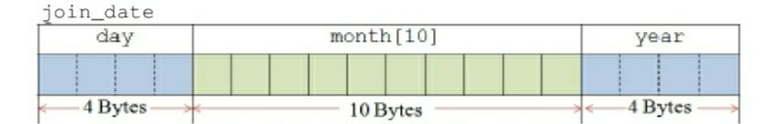
Memory allocation
Eg.
struct strdate
{
int day;
char month[10];
int year;
};
strdate join_date;
The memory allocation of the structure variable requires
18 Bytes of memory
Joffy's Insights

Slide 13
A structure variable can be declared along with the definition also
Eg.
struct complex
{
short real;
short imaginary;
} c1, c2;
Joffy's Insights

Slide 14
If we declare structure variables along with the definition, structure tag (or structure name) can be avoided
Eg.
struct
{
int a,b,c;
} eqn1, eqn2;
Joffy's Insights

Slide 15
Variable Initialisation
Syntax :
structure_tag variable = {value1,value2,………,valueN};
Eg. struct student
{
int adm_no;
char name[20];
char group[10];
float fee;
};
student s = {3452,”Vaishakh”,”Science”,270.00};
Joffy's Insights

Slide 16
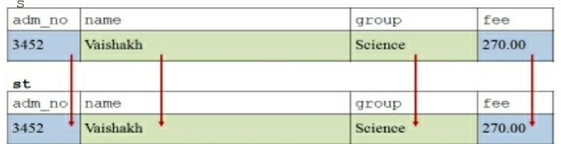
A structure variable can be assigned with the values of another structure variable. But both of them should be of the same structure type.
Eg. student st = s;
Joffy's Insights

Slide 17
Accessing elements of structure
The period symbol ( . ), named as dot operator is used for accessing elements of a structure variable.
Syntax :
structure_variable.element_name
Eg.
today.dd = 10;
strcpy(adm_date.month, “June”);
cin>>s1.admno;
cout<<c1.real + c2.real;
Joffy's Insights

Slide 18
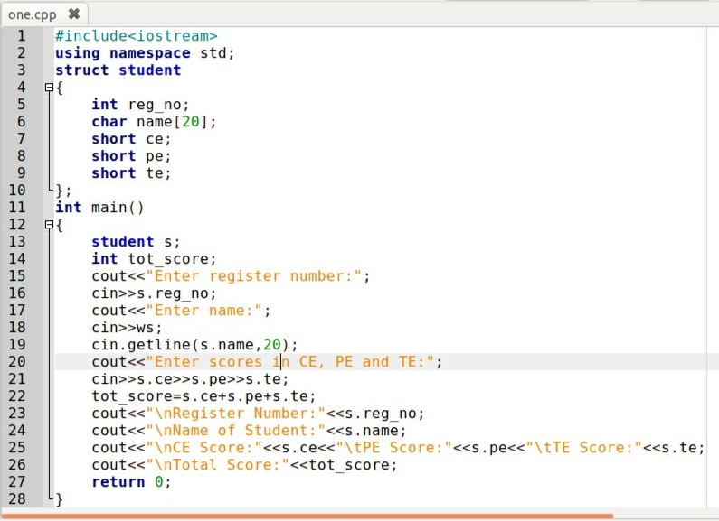
Write a program to find the total score of a student
Joffy's Insights

Slide 19
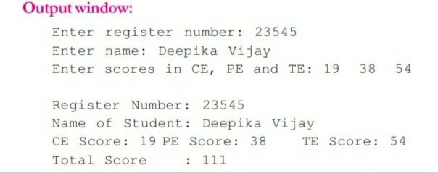
To store the details of more than one student, array of structures is used.
Nested Structure
When an element of a structure may itself be another structure, Such a structure is known as nested structure
Joffy's Insights

Slide 20
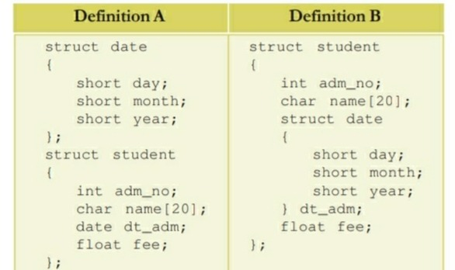
Example for nested structure variable Initialisation and accessing of elements of nested structure variable.
student s = {4325,”Vishal”,{10,11,1997},575};
cout<<s.admno<<s.name
cout<<s.dt_adm.day<<”/”<<s.dt_adm.month<<”/”<<s.dt_adm.year;
Joffy's Insights

Slide 21
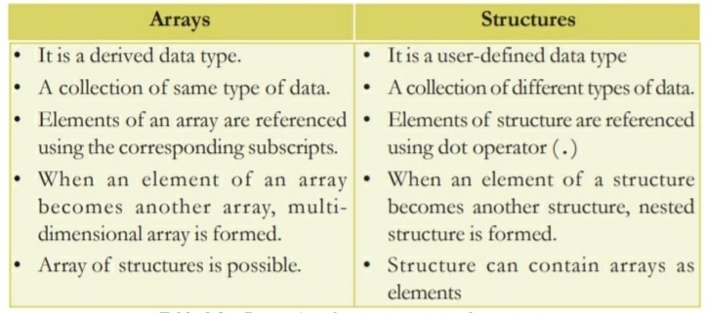
format for accessing inner structure element is outer_structure_variable.inner_structure_variable.element
Array Vs Structure
Joffy's Insights

Slide 22
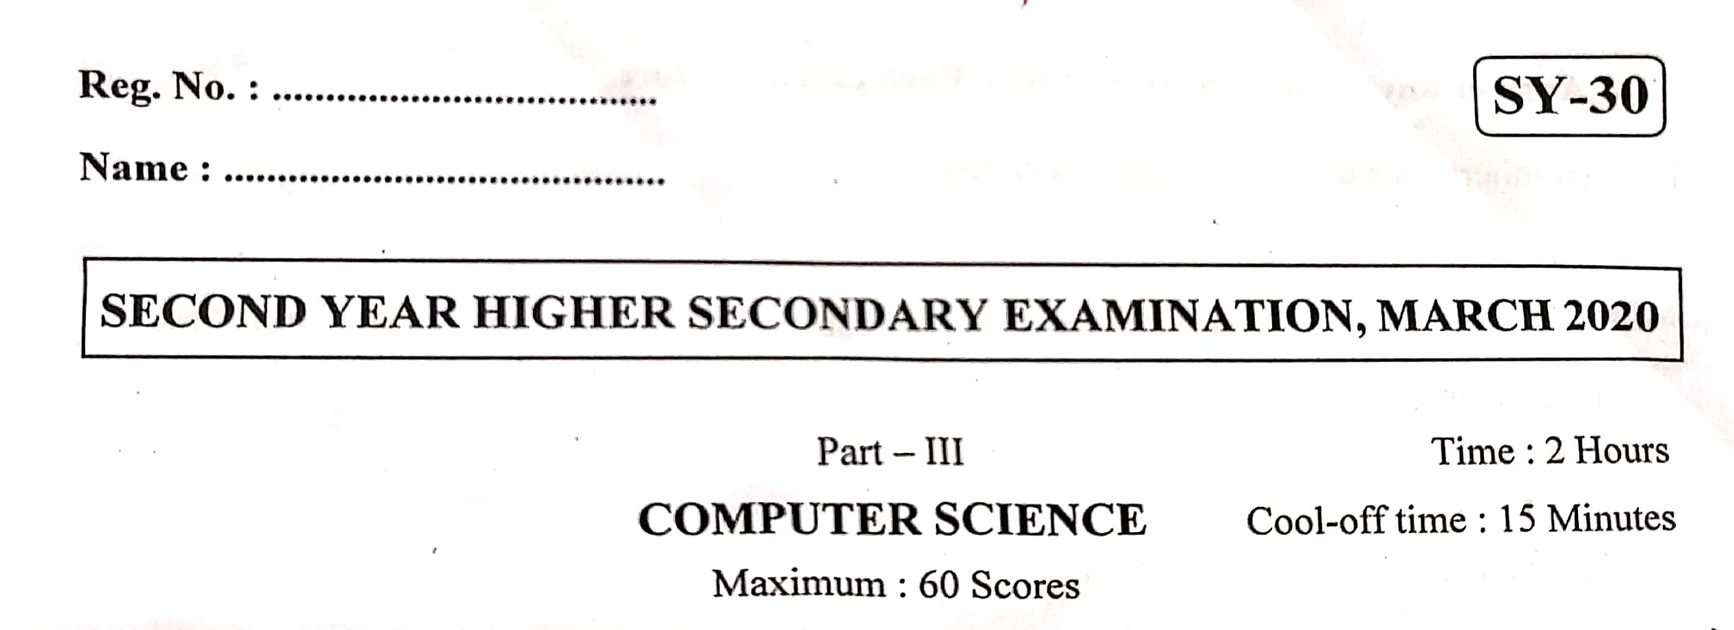
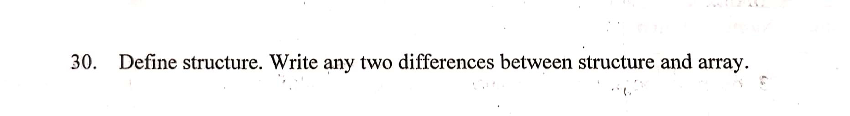
Joffy's Insights

Slide 23
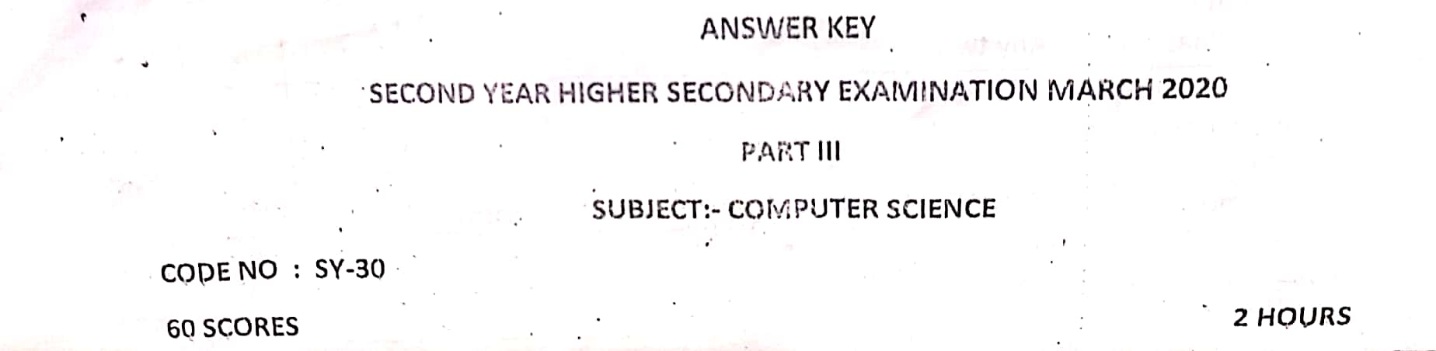
Joffy's Insights

Slide 24
thaikkad.com
Joffy's Insights

